Slide 1
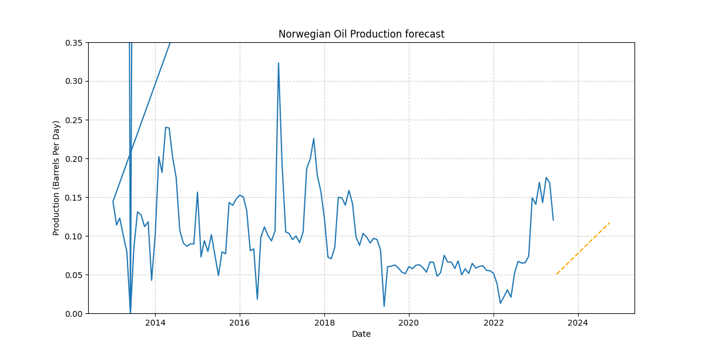
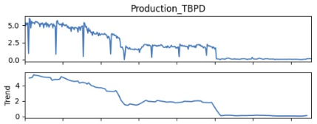
Greater Ekofisk Area Analysis
Production in the Ekofish area follows a clear seasonal pattern, peaking in the summer and hitting the lowest point in the winter.
The production number has fallen over the Years but the fluctuation has decreased as well
Government incentive programs aimed at boosting winter production may have a output together with the techlogical advance.
With Statistical Models help i could forecast that the production of oil will get a little recover in the next year and the fluctuation will remain in a stable line.

